Slide 1
Computer Graphics: Rendering
Lecture 2: Radiometry, Photometry
Kartic Subr

Slide 2
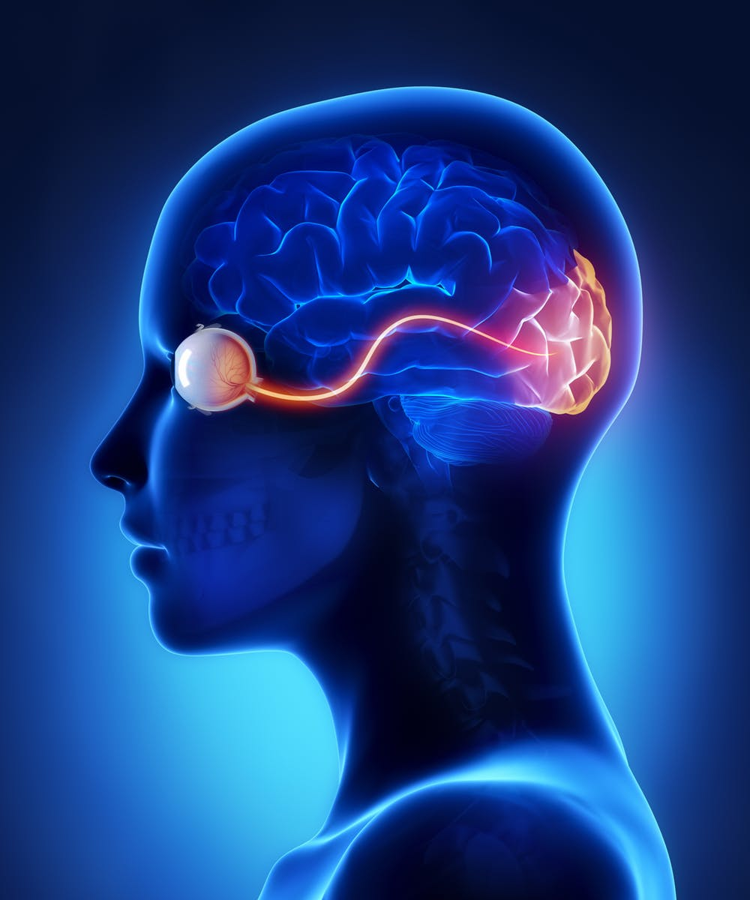
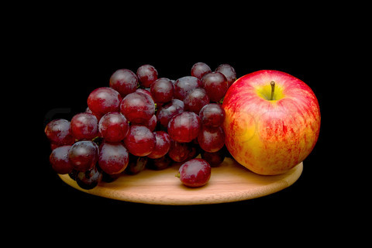
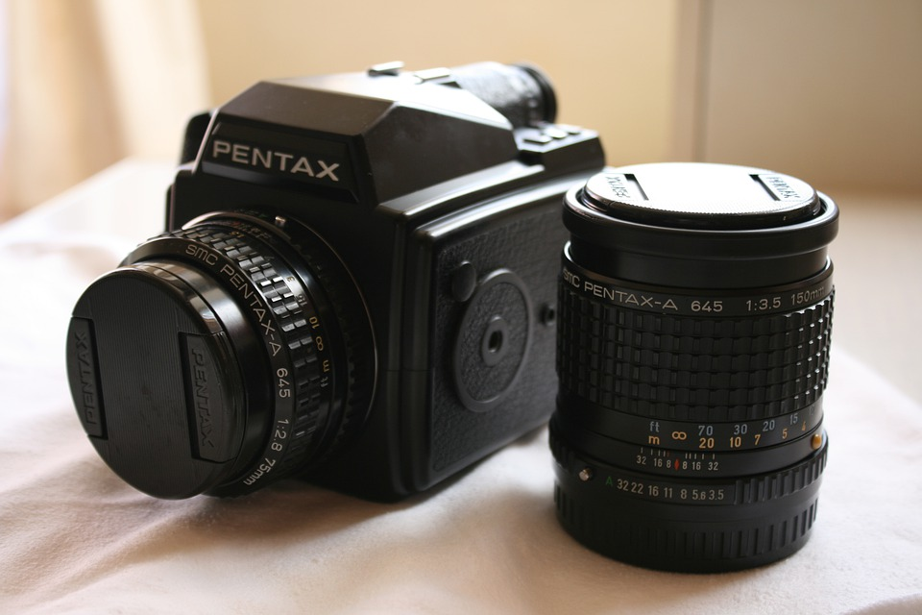

Computer Graphics
Real
photography
image manipulation
rendering
Virtual

Slide 3
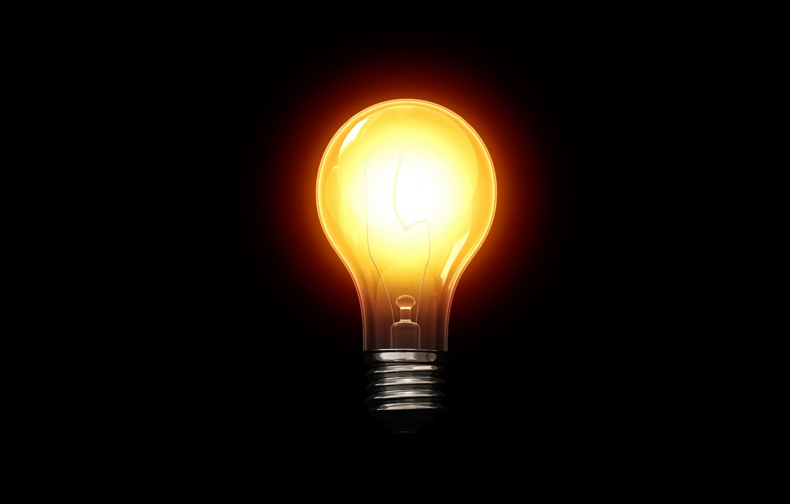
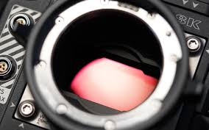
Energy in the scene
Cool visualization in this video

Slide 4

What do cameras record?
Obviously, it is …ehmm
…‘light stuff’?

Slide 5
What is light?

Slide 6
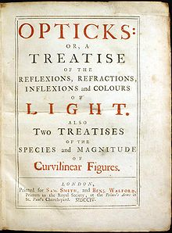
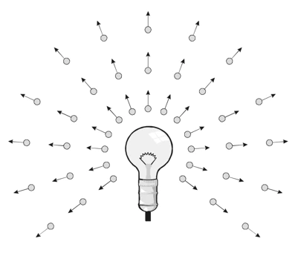
What is light?
Isaac Newton 1704

Slide 7
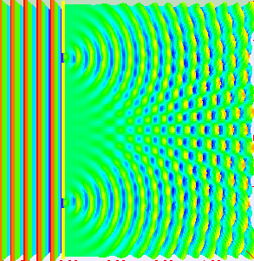
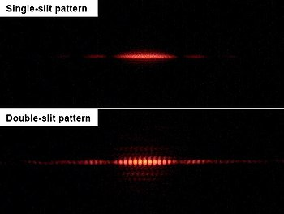
What is light?
Isaac Newton 1704
Thomas Young 1801

Slide 8
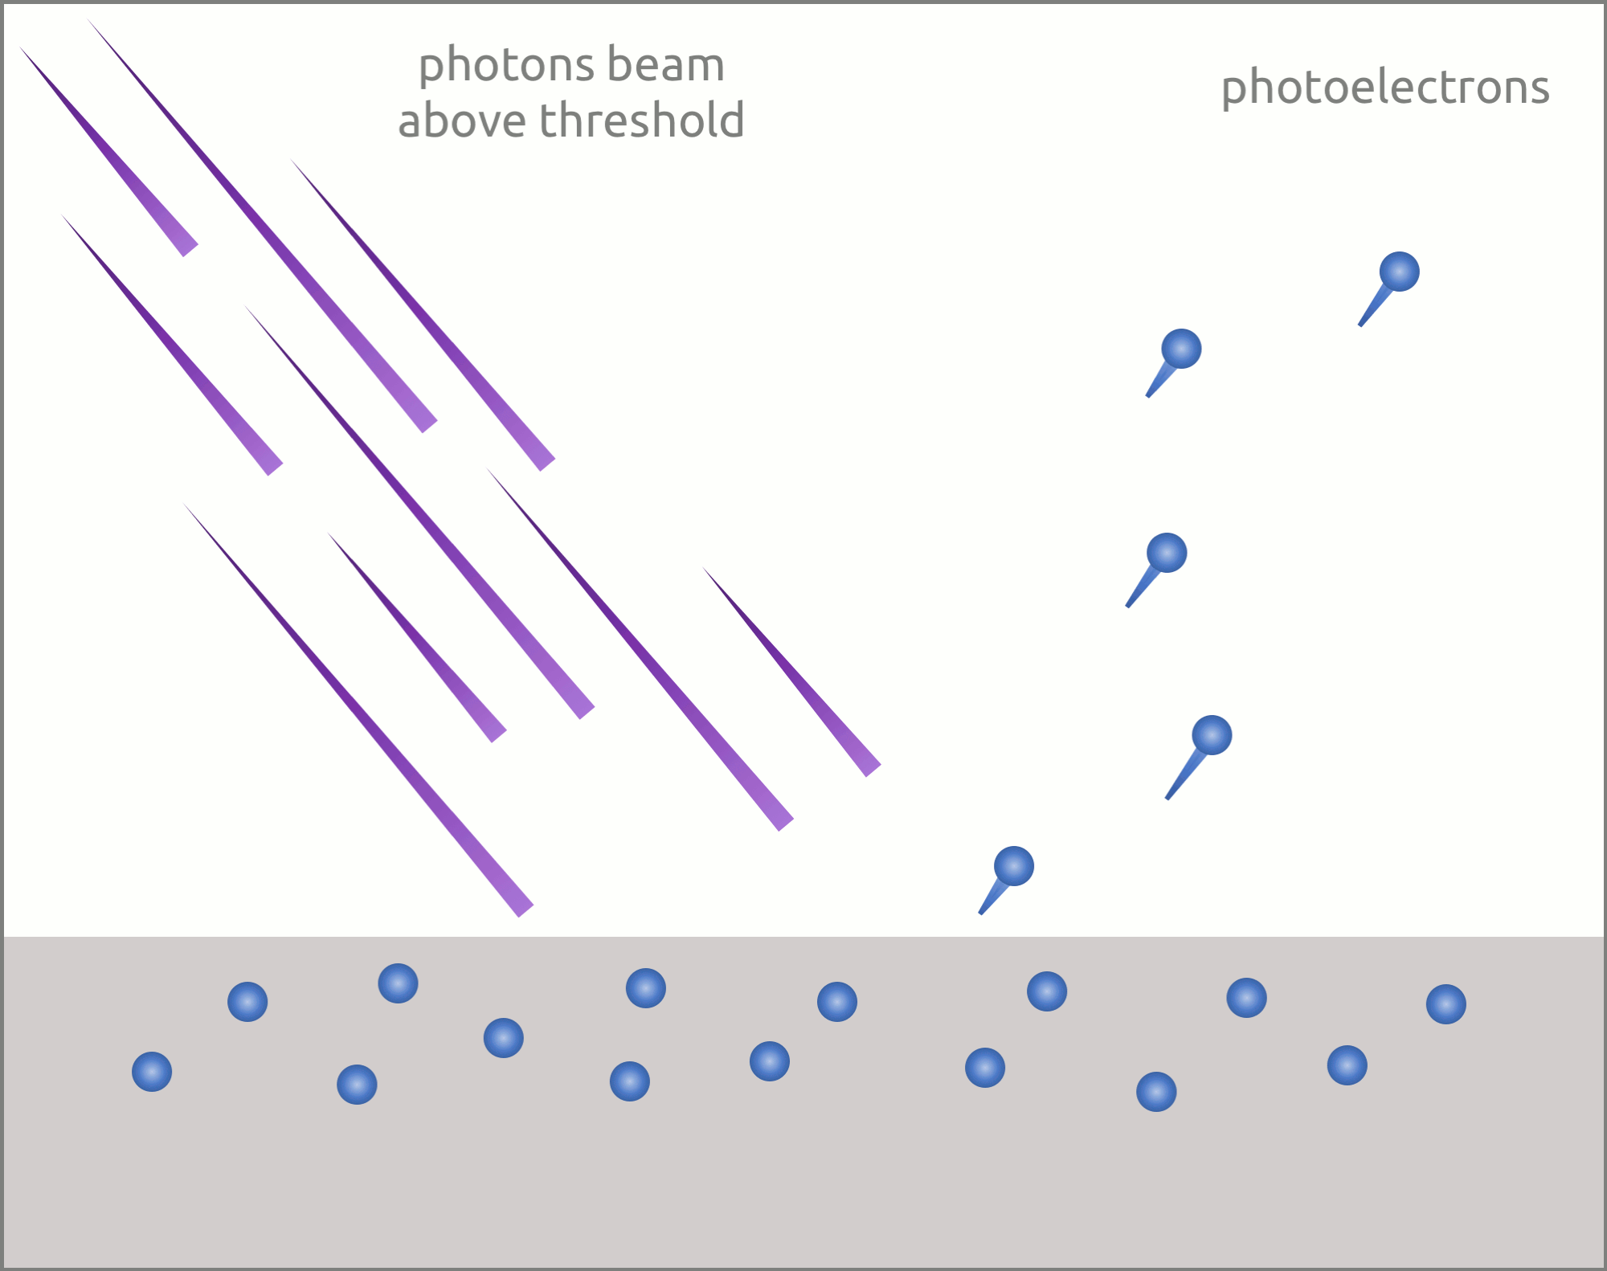
What is light?
Isaac Newton 1704
Thomas Young 1801
1887 Hertz, 1902 Lenard, 1905 Einstein

Slide 9
Does light travel in straight lines? Explain?

Slide 10
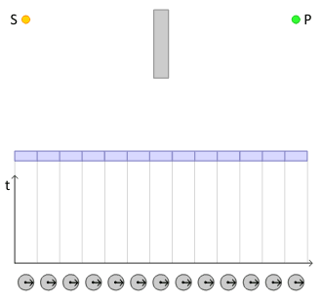
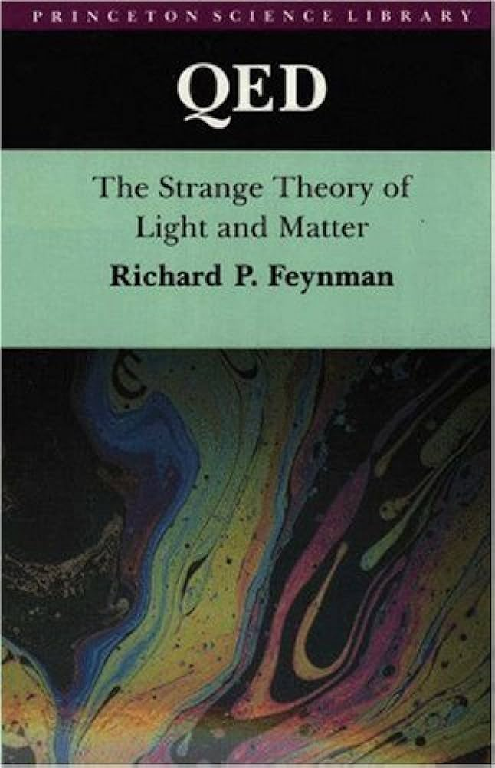
Straight lines?
Feynman 1985

Slide 11
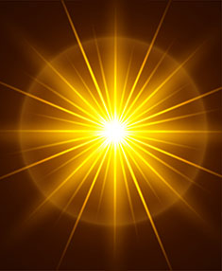
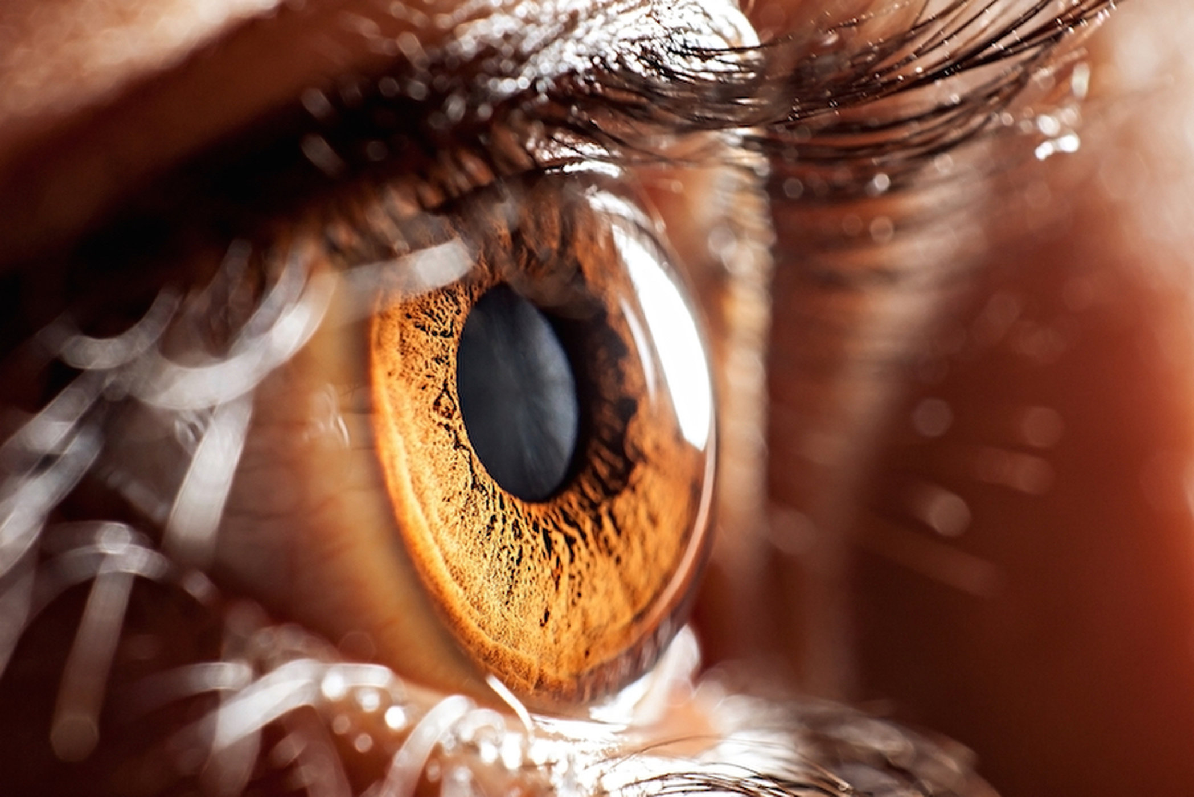
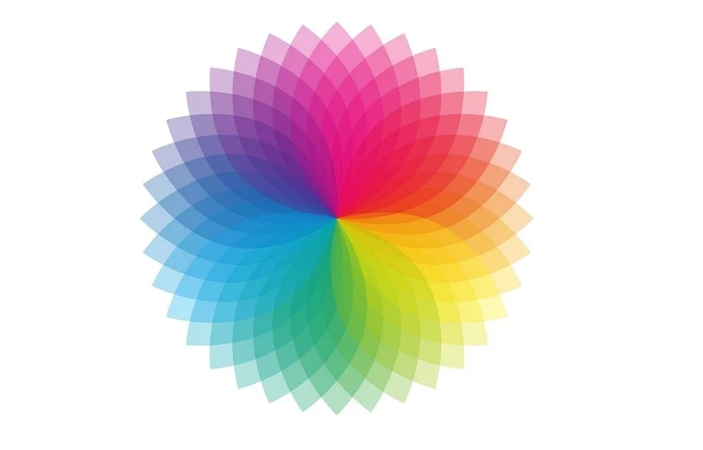
The study of light
radiometry
photometry
colorimetry
Interested in knowing more? Read this

Slide 12
Radiometry

Slide 13
Radiometry
Study of light energy in a scene

Slide 14
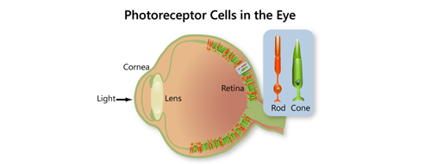
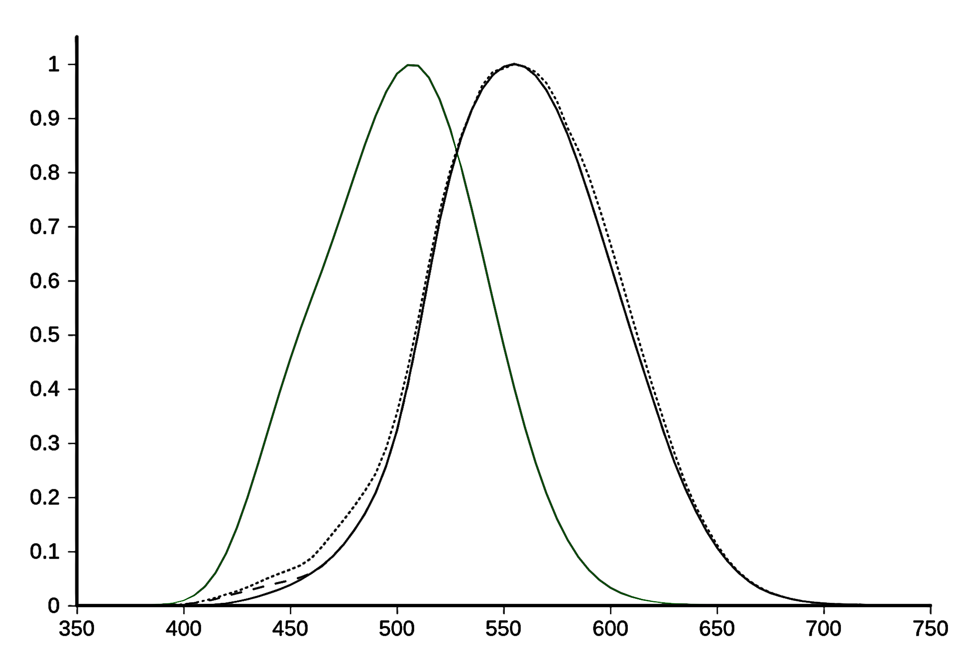
Photometry
Study of perceived light energy in a scene

Slide 15
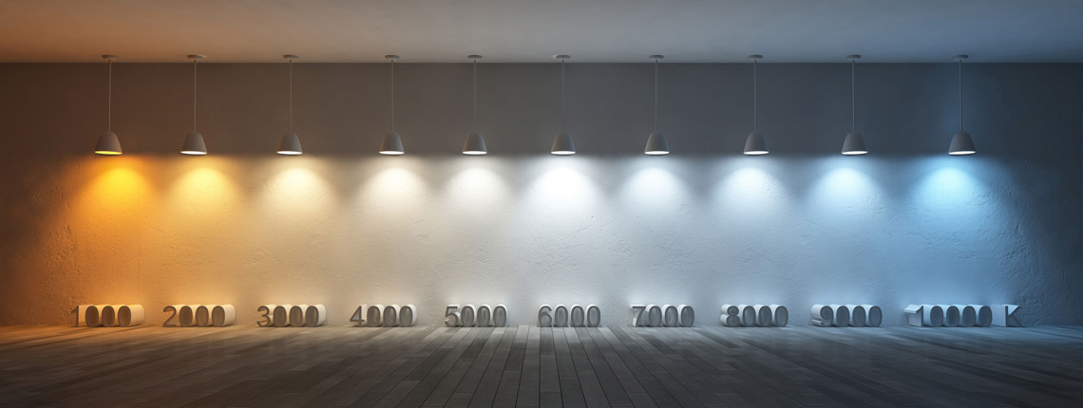
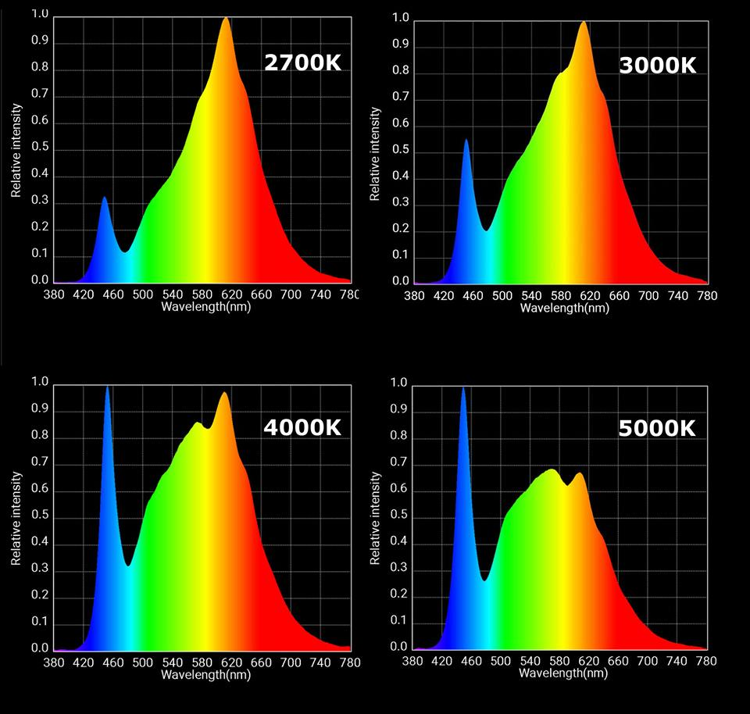
Spectrometry: radiometric qty. per wavelength
https://www.softlights.org/chapter-11-color-temperature/
Interested in modelling this? Look here

Slide 16
Spectral sensitivity of our eyes

Slide 17
Spectral response of cones

Slide 18

Rods, cones, etc.

Slide 19
plotting S,M,L as 3D points as a function of wavelength

Slide 20
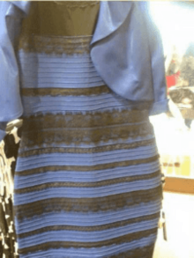
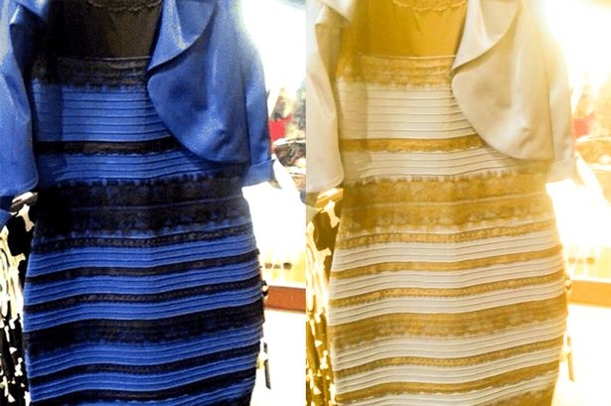
Metamers
http://persci.mit.edu/people/adelson/checkershadow_proof

Slide 21
Trichromatic theory of light

Slide 22
Trichromatic theory of light

Slide 23
Matching Experiment
tweak sliders
r
target colour
observed
colour
g
b

Slide 24
Matching Experiment
g
r
b

Slide 25
Tristimulus values

Slide 26
Tristimulus values

Slide 27
Tristimulus values
Confusing? Read more here
(search for ‘Maxwell’ on the page)
or here

